Slide 1
CLECKHUDDERFAX Online Megastore
Project Management Group A

Slide 2

Together we can

Slide 3

Members
Dikson Rajbanshi (Leader)
Discussion:
Time: 4 mins
Role: Co-Ordinator (Primary)
Specialist (Secondary)
Monitor Evaluation (least likely)
Surya Shrestha
Discussion:
Time: 4 mins
Role: Implementor (Primary)
Resource Investigator (Secondary)
Complete Finisher (least likely)

Slide 4
Prasansa Dahal
Discussion:
Time: 4 mins
Role: Specialist (Primary)
Complete Finisher (Secondary)
Plant (least likely)
Susan Khatri
Discussion:
Time: 4 mins
Role: Resource Investigator (Primary)
Implementor (Secondary)
Shaper (least likely)
Alok Raj
Discussion:
Time: 4 mins
Role: Shaper (Primary)
Team Worker (Secondary)
Plant (least likely)

Slide 5
Logo

Slide 6

Why CLECKHUDDERFAX Online Megastore?
E-Commerce Site
We all know e-commerce is commercial transaction medium
conducted electronically on the internet. This site is not just for
commercial purpose but also for promoting our city in the globe.
We will influence local markets and traders rather than promoting
mart randomly and the category will be selective too.
Easy Accessible
Online shopping is globally most used platform. With the help of our e-commerce website traders
can put their products on online market and retail from our website. Also they will be recognized
globally.

Slide 9
Project Organization
Team Members
Dikson Rajbanshi
Surya Shrestha
Prasansa Dahal
Alok Raj
Susan Khatri
Planning
Slack
Trello
Google Drive
MS Project

Slide 10
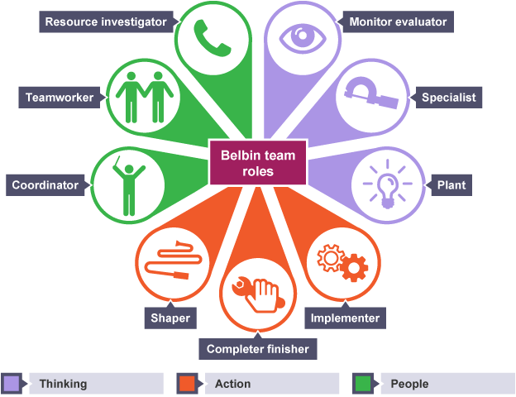
Belbin Analysis

Slide 11
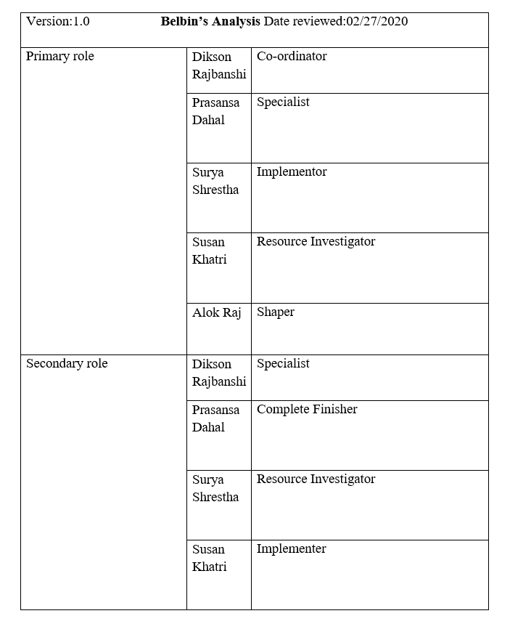
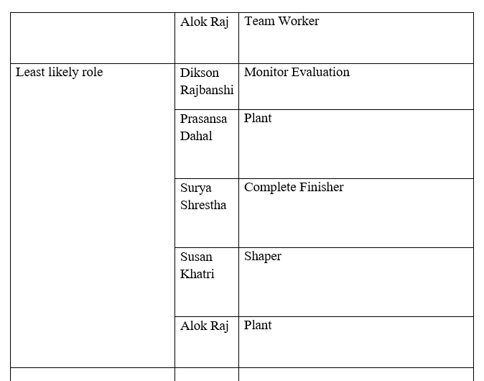

Slide 12

Skill Audit

Slide 13
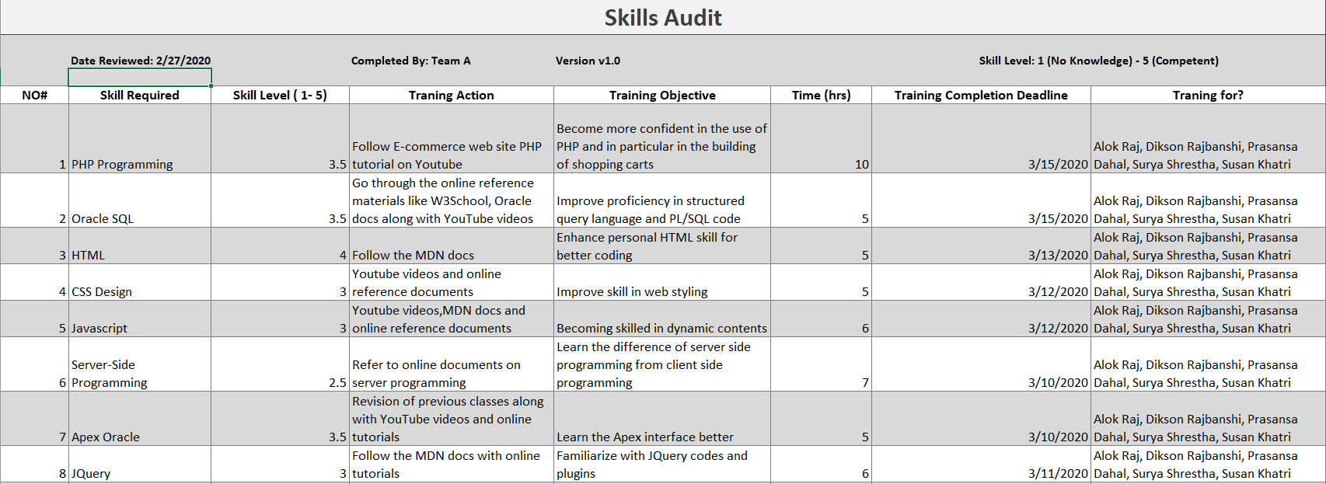

Slide 14
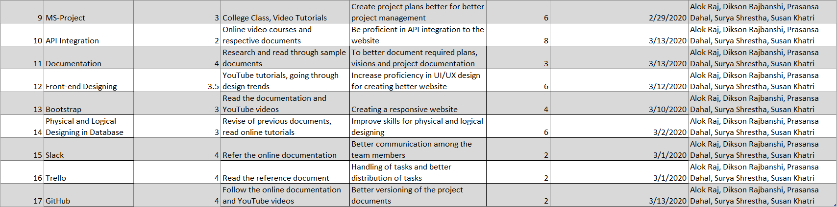

Slide 15
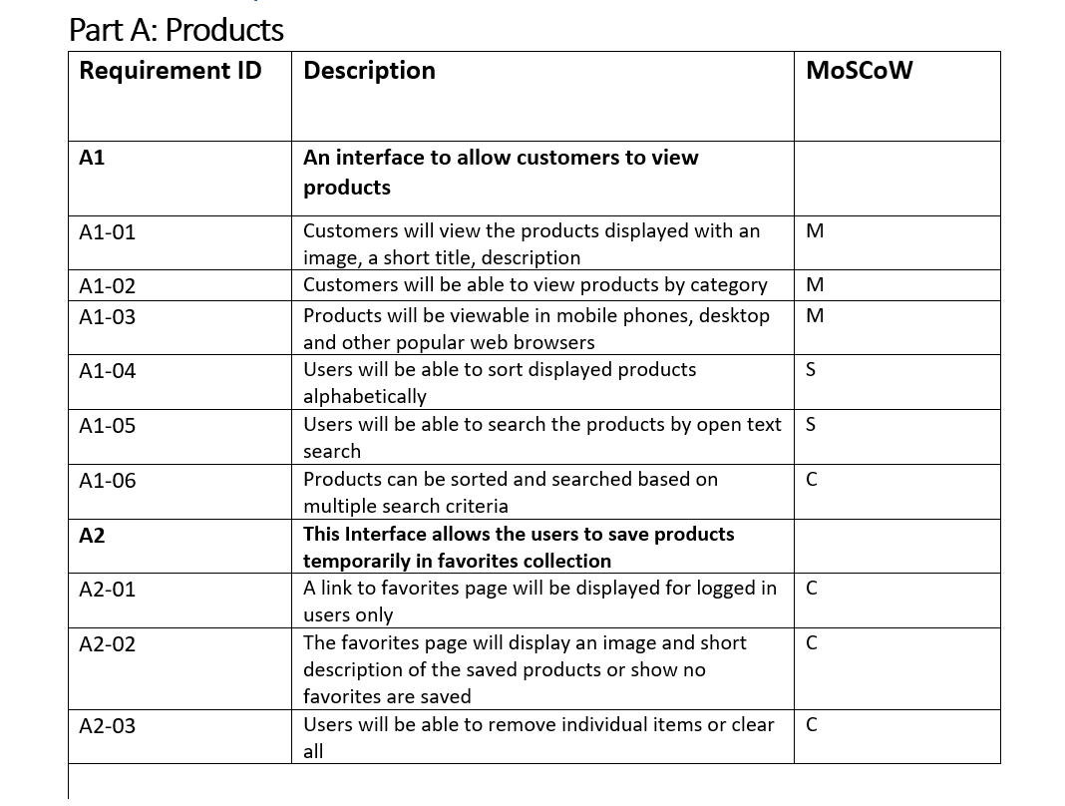
Requirement Catalogue

Slide 16
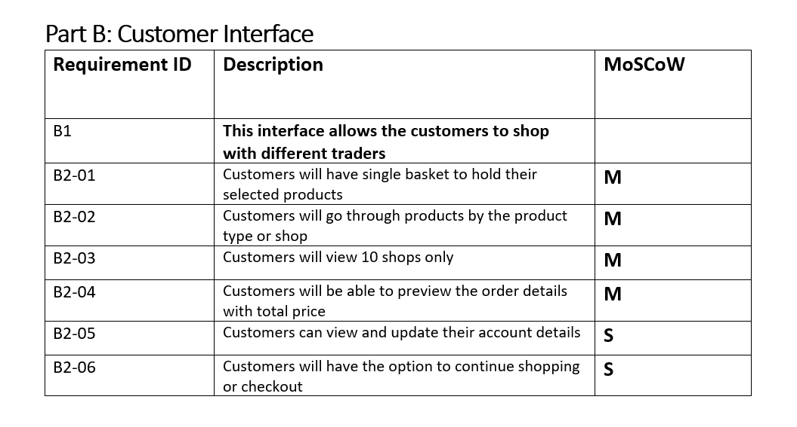

Slide 17
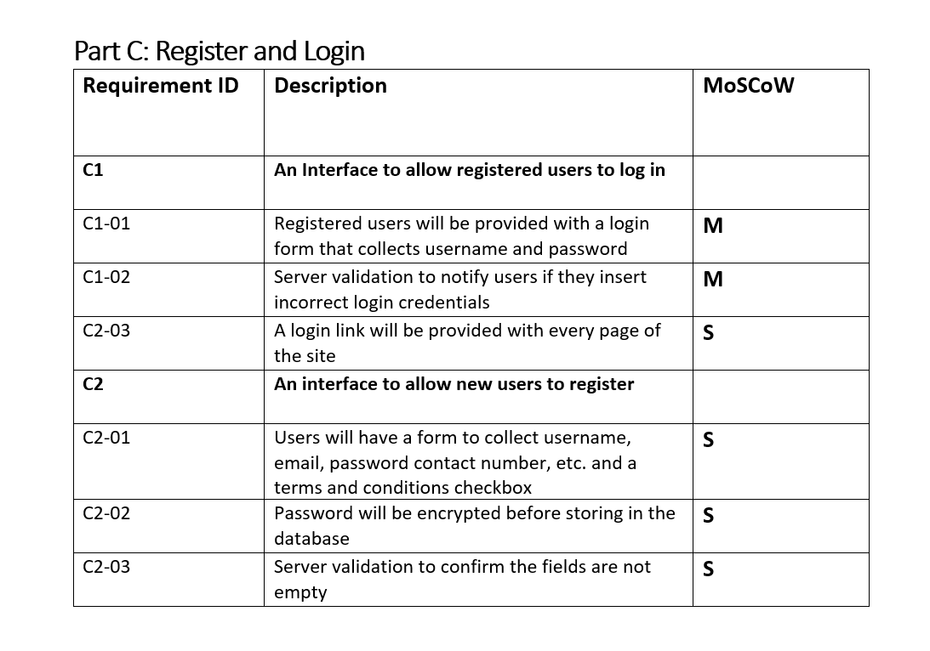

Slide 18
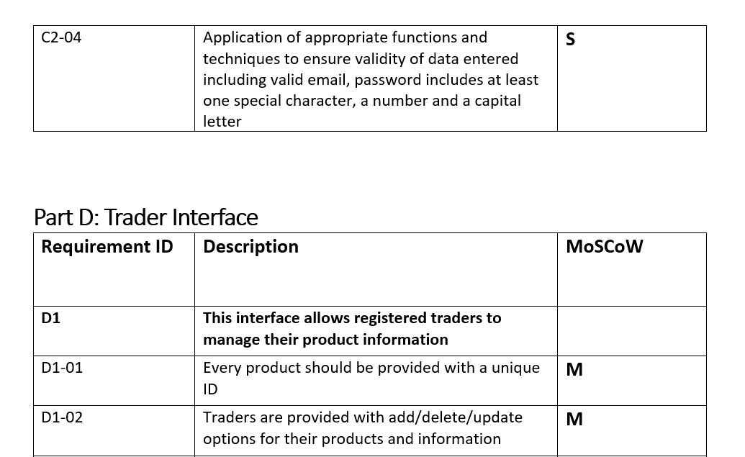

Slide 19
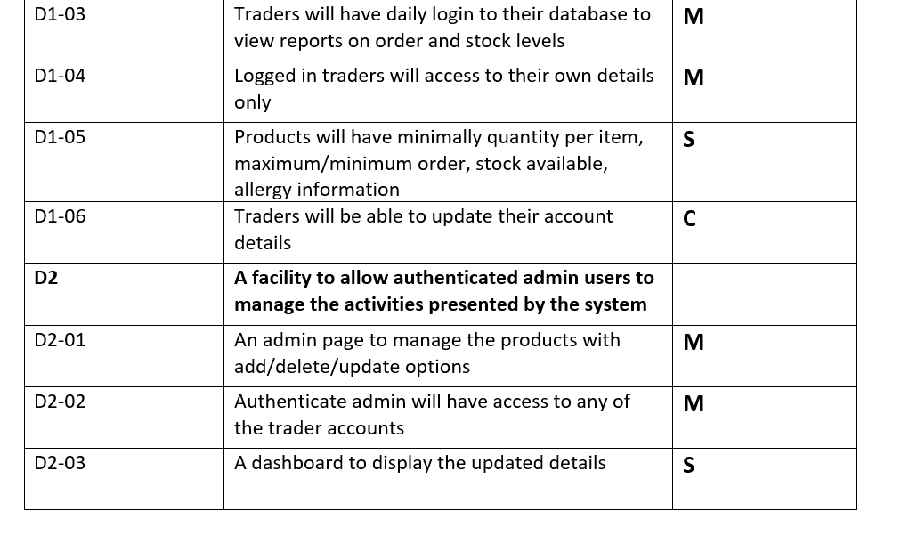

Slide 20
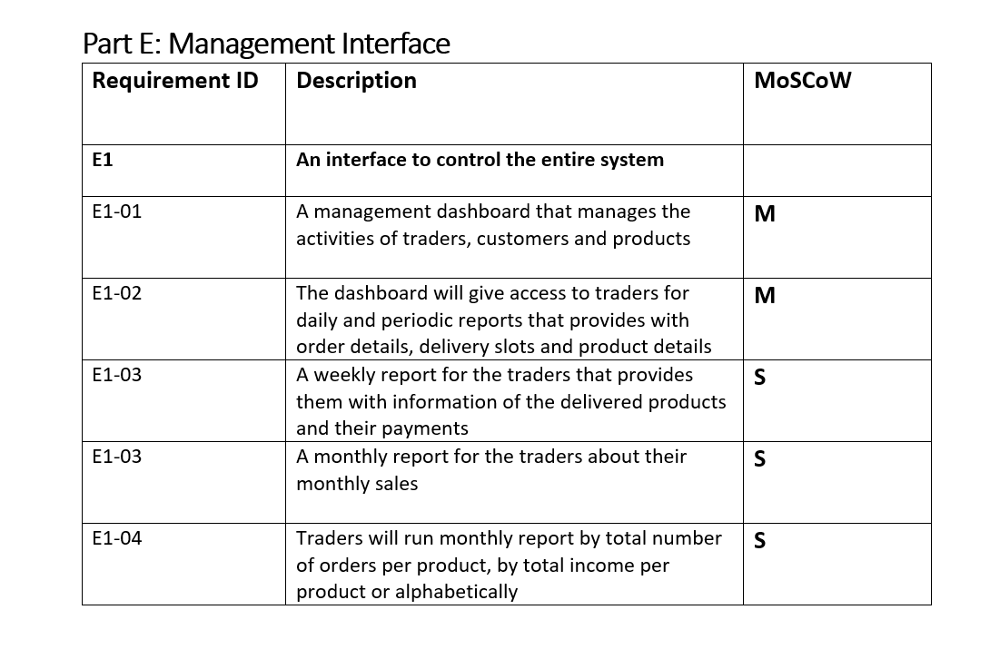

Slide 21
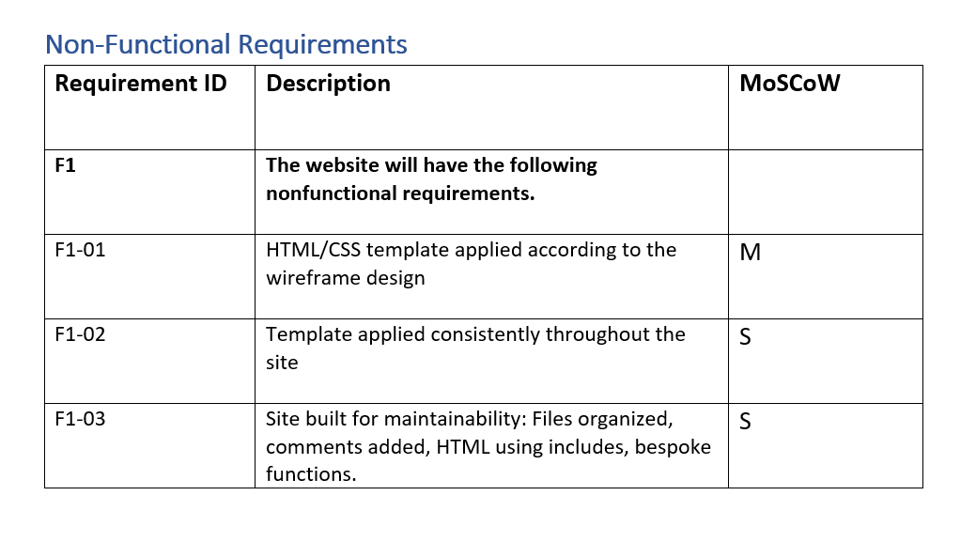

Slide 22
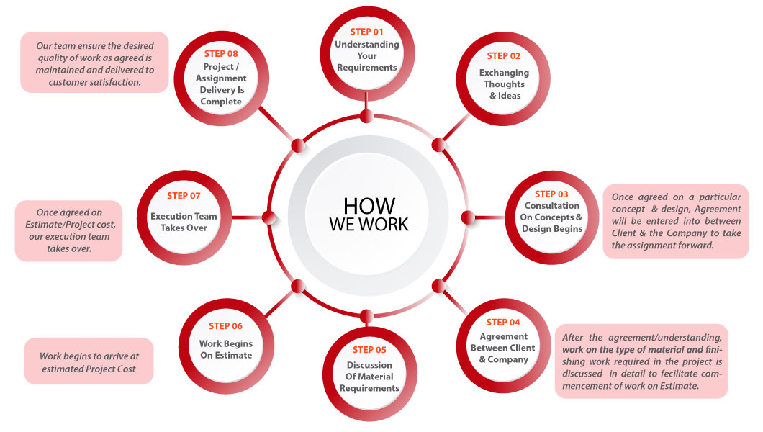
Execution

Slide 23
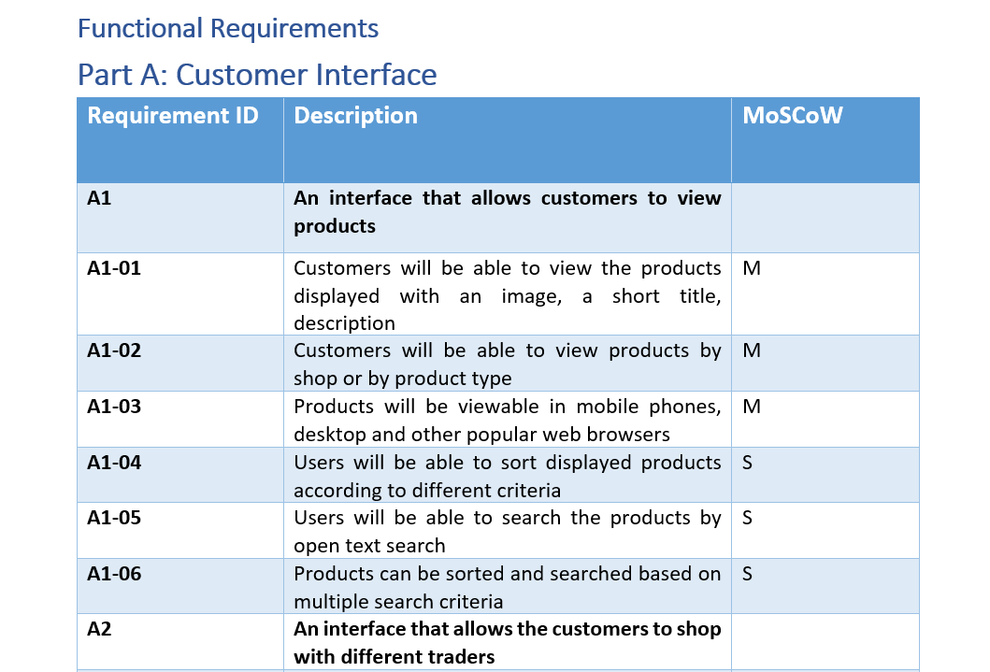
Requirements

Slide 24
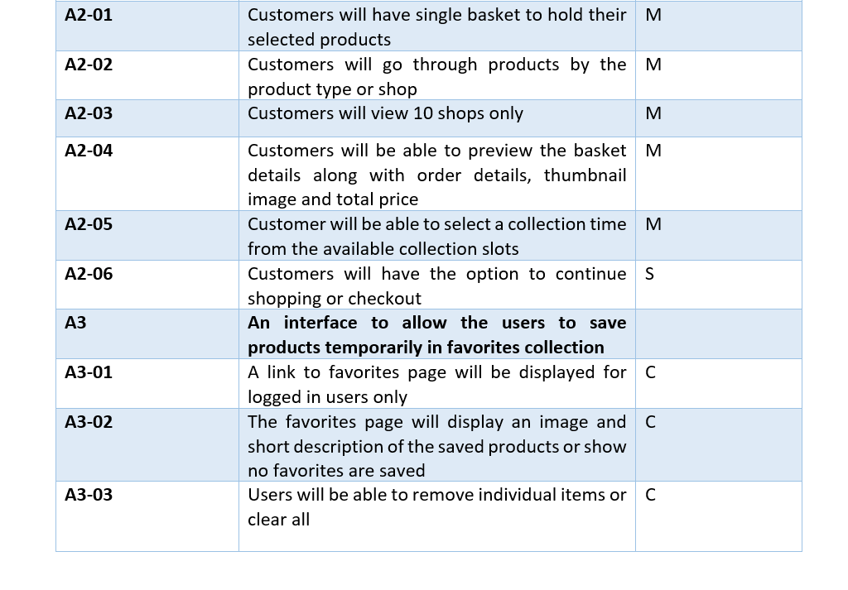

Slide 25
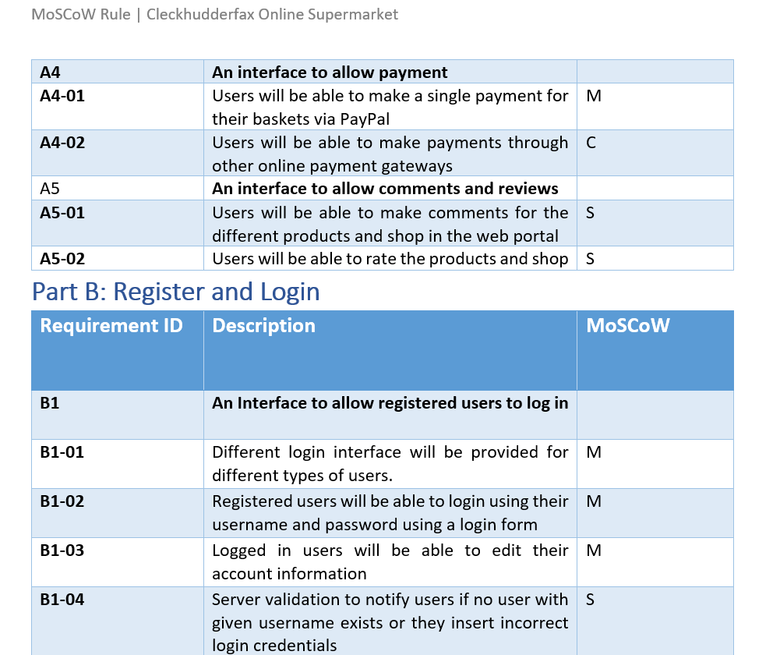

Slide 26
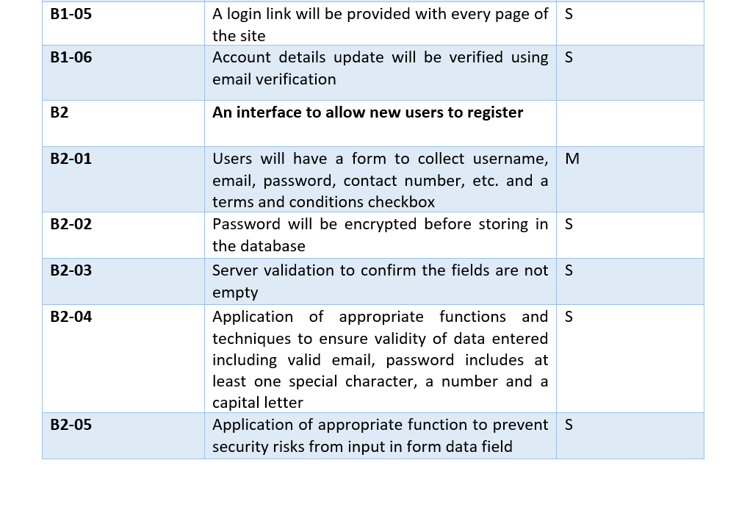

Slide 27
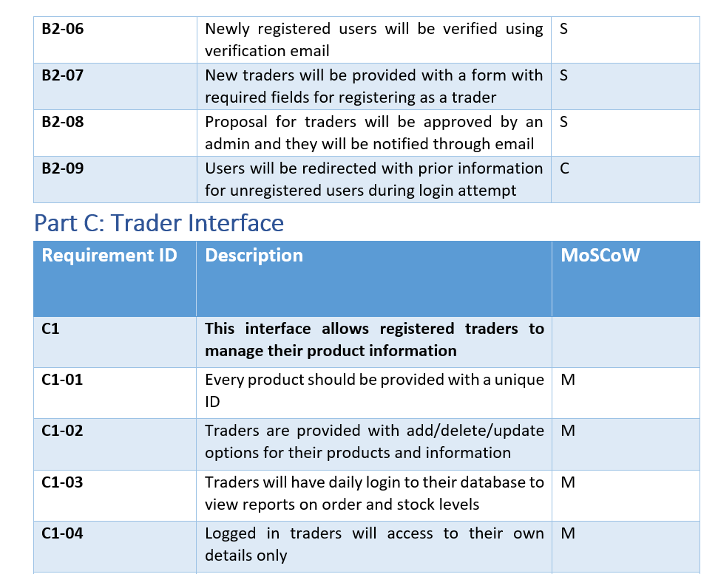

Slide 28
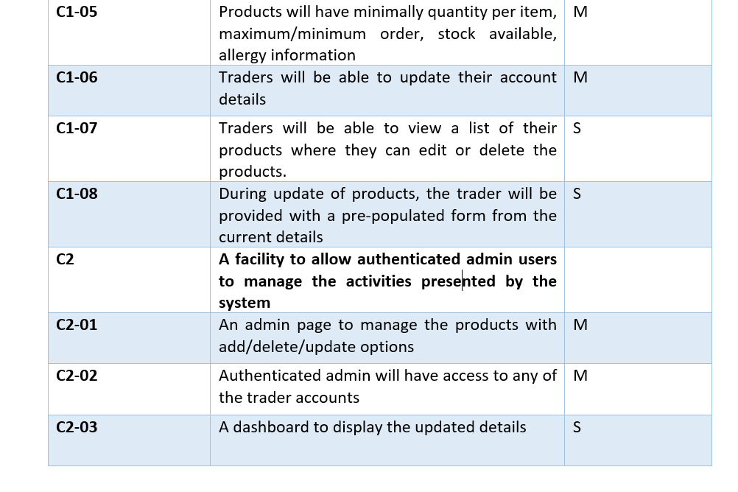

Slide 29
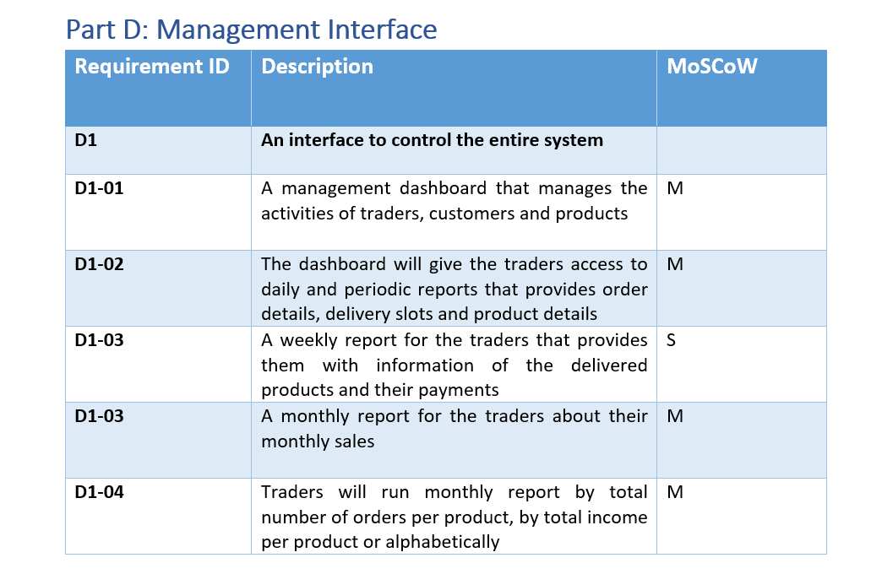

Slide 30
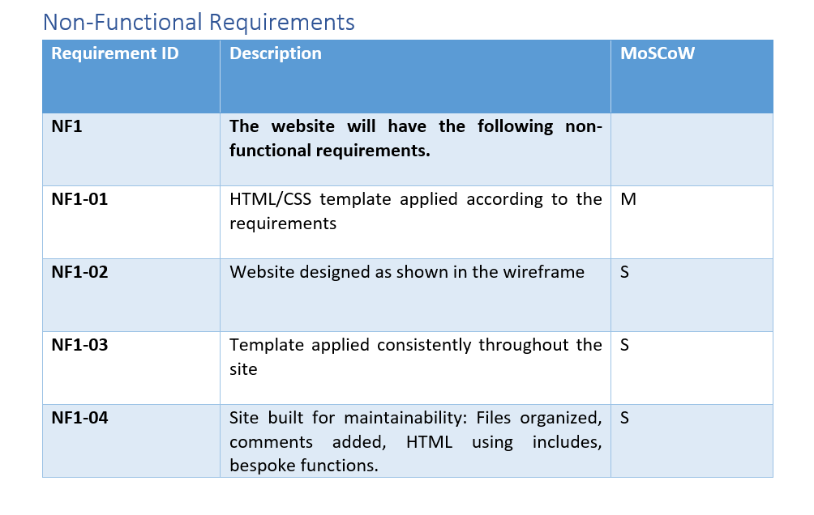

Slide 31
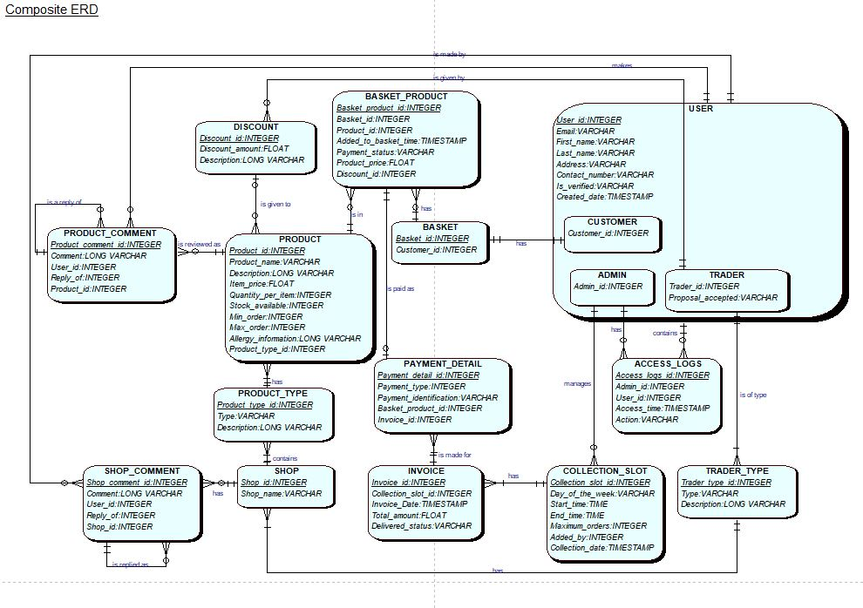
Composite ERD

Slide 32
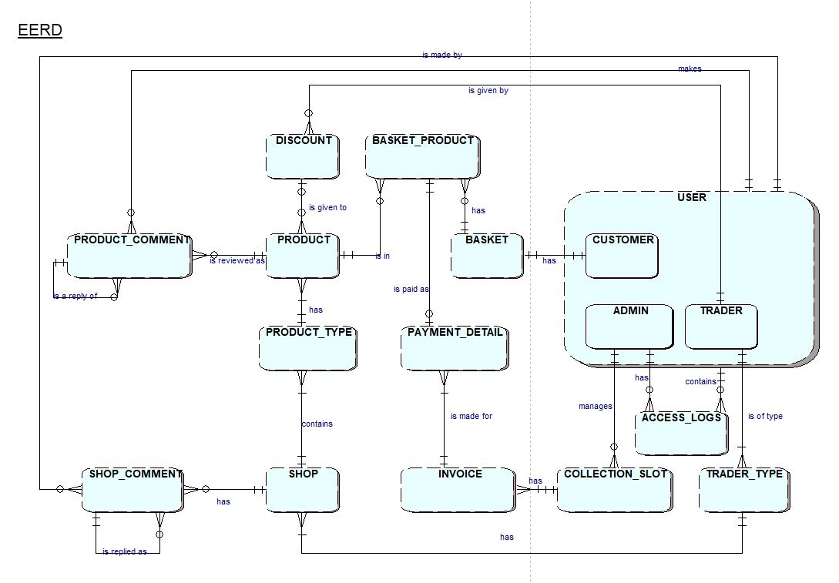
EERD

Slide 33
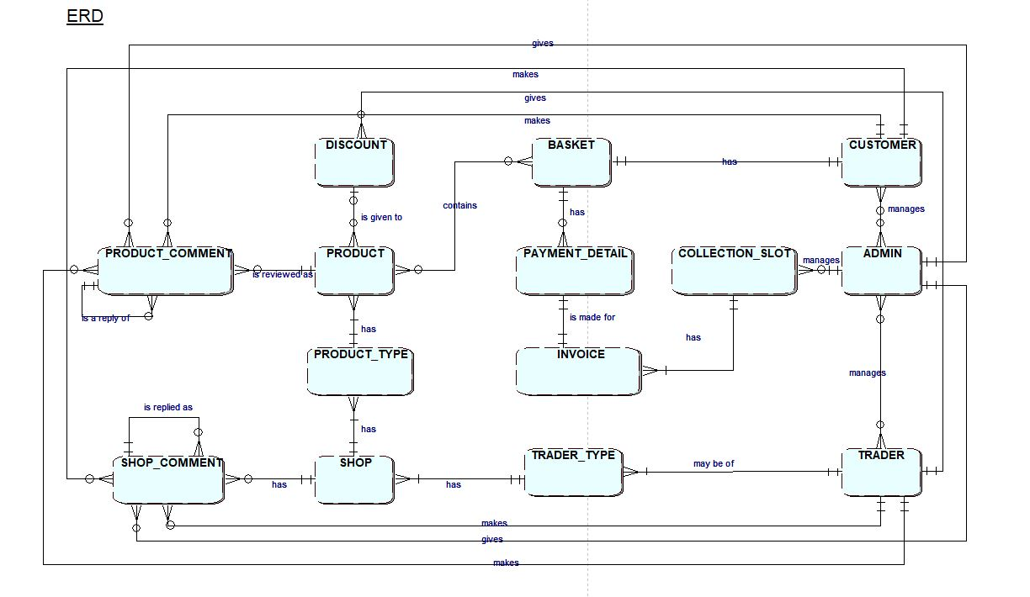
ERD

Slide 34
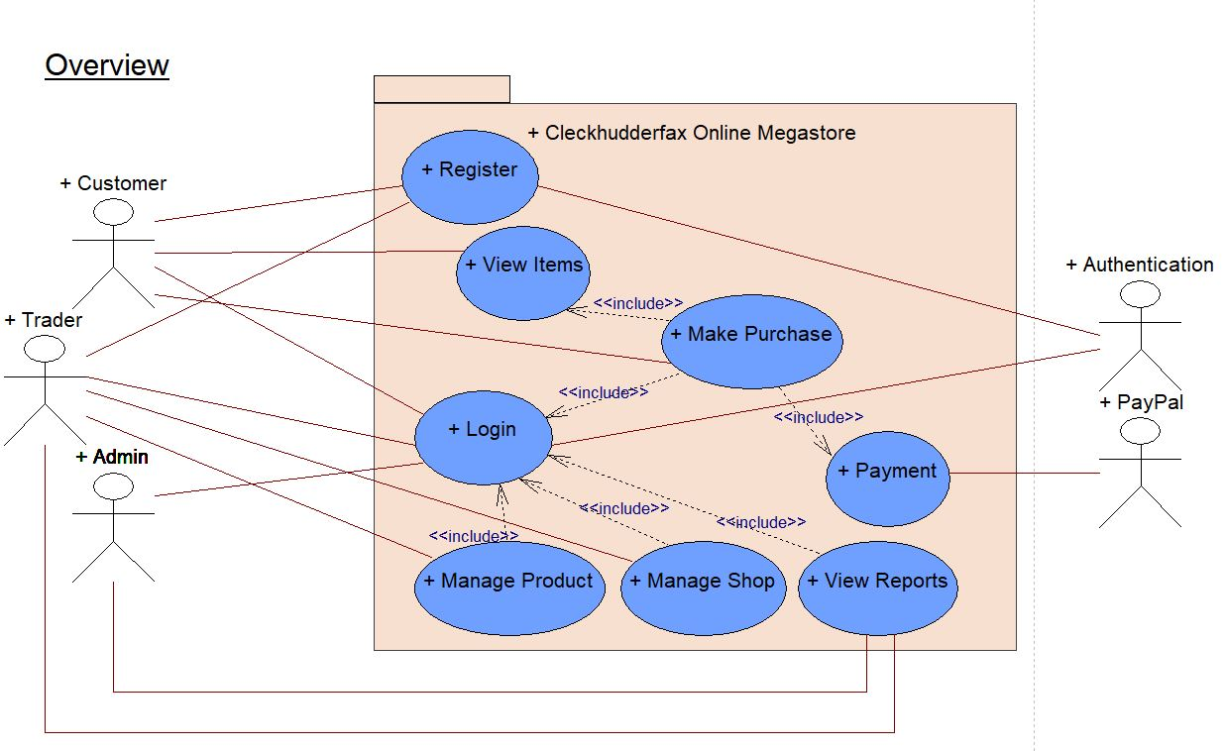
USE Case
Overview

Slide 35
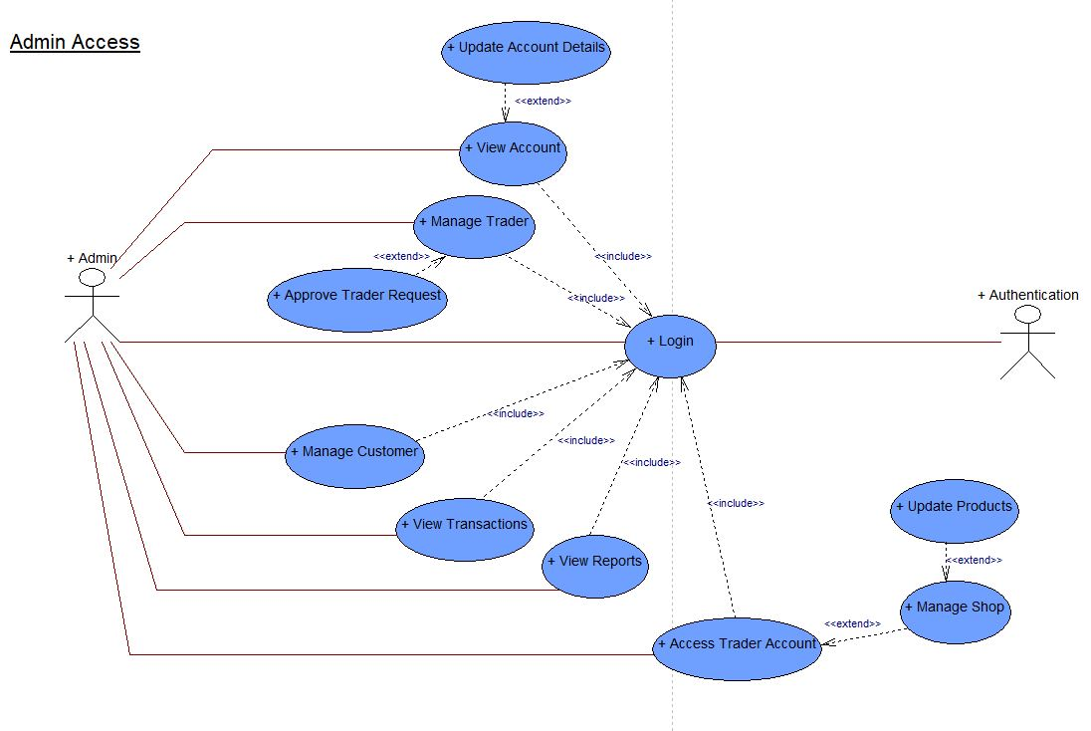
Admin Access

Slide 36
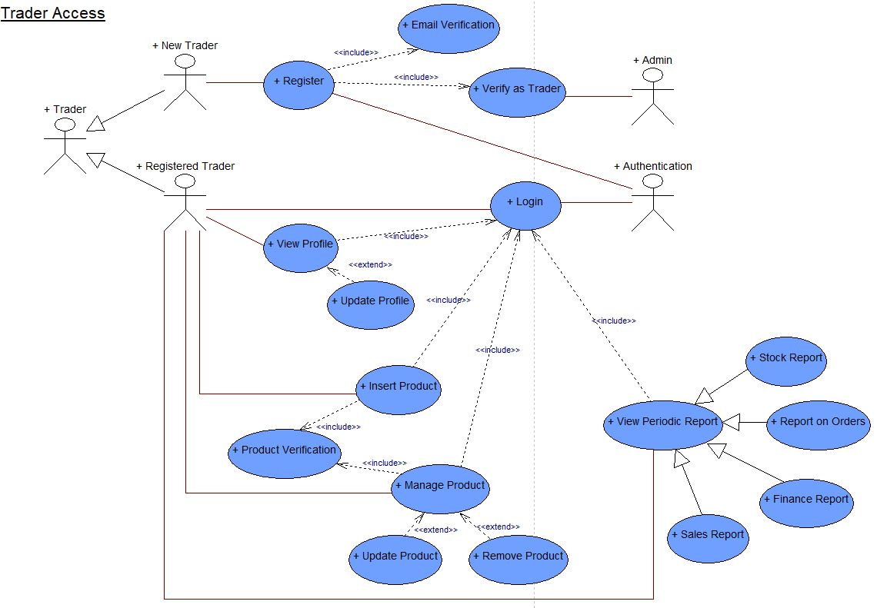
Trader Access

Slide 37
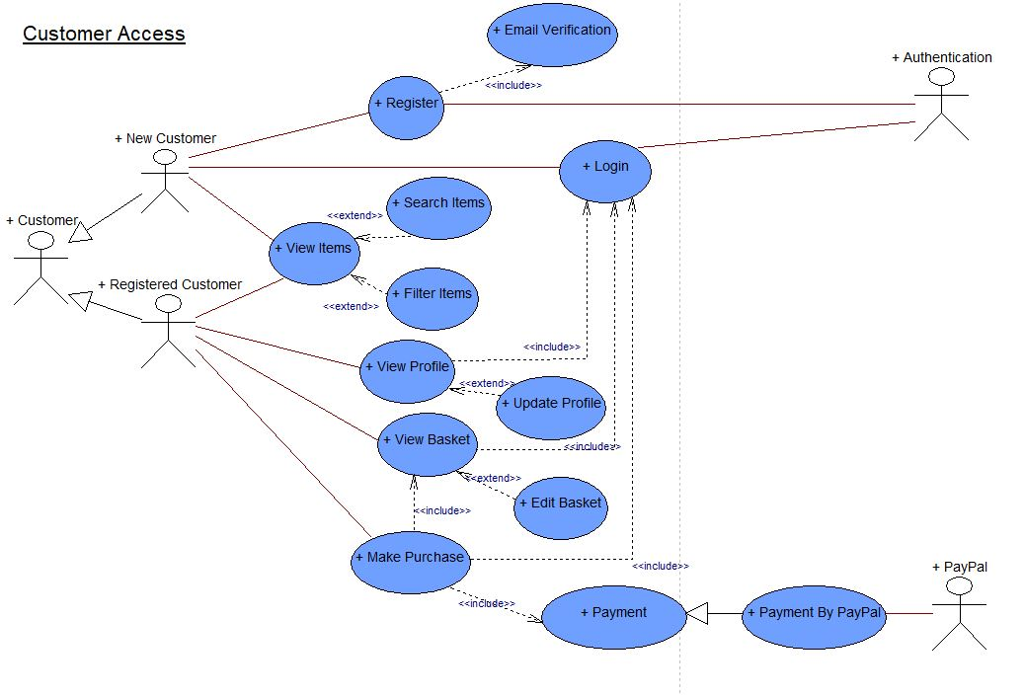
Customer Access

Slide 38
ERD Use Case

